Slide 1


License Plate Reader
Technology
City Council Briefing
Public safety value, privacy, accountability,
and transparent governance.
Notes:
[Sources]
Page PD LPR Council Presentation.pptx, title framing and visual identity.
Cummulative ALPR Benefit Doc.docx, lines 64-72: public safety, privacy, constitutional oath, transparency and accountability.

Slide 2
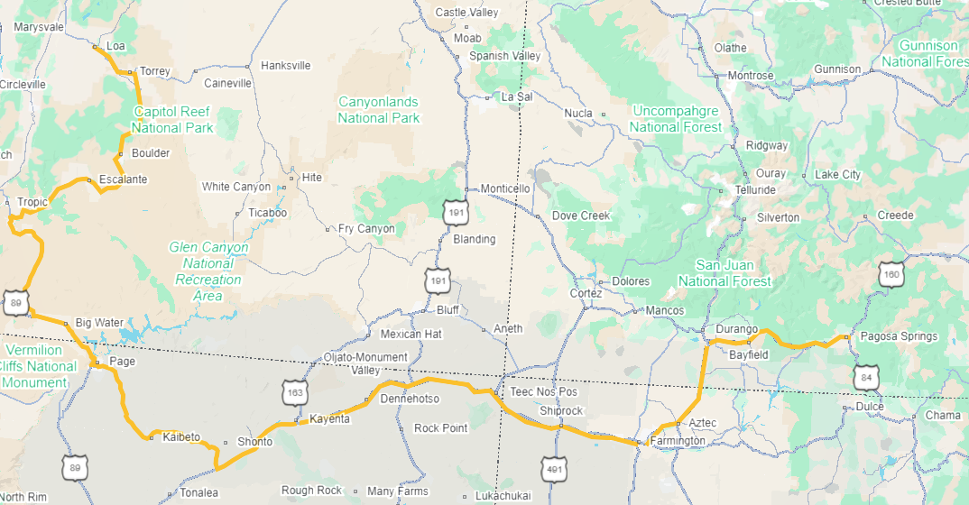

Why Page Uses LPR Technology
A focused investigative tool that helps personnel find vehicle leads faster — while officers still make the decisions.
Locate stolen vehicles and vehicles connected to crimes.
Assist with missing, endangered, or wanted persons when a vehicle is involved.
Develop investigative leads that may otherwise take hours or days to identify.
Support faster, safer decisions with objective vehicle-detection information.
PAGE PD EXAMPLE
Multi-state homicide suspect search
A suspect vehicle was identified moving through Page. Investigators expanded the notification area, and a later alert near Durango helped track the vehicle toward Pagosa Springs.
6,675
vehicles passed one Page LPR that day; only the specific suspect vehicle was queried.
Notes:
[Sources]
Cummulative ALPR Benefit Doc.docx, lines 32-36 and 65-66: investigative uses and human decision-making.
Page PD LPR Council Presentation.pptx, lines 289-319: multi-state homicide suspect example and 6,675 vehicle figure.
08-25 Law Enforcement Technology, Policy, and Public Trust-Summary.docx, lines 33-40: ALPR as a force-multiplier and importance of real-world success stories.

Slide 3
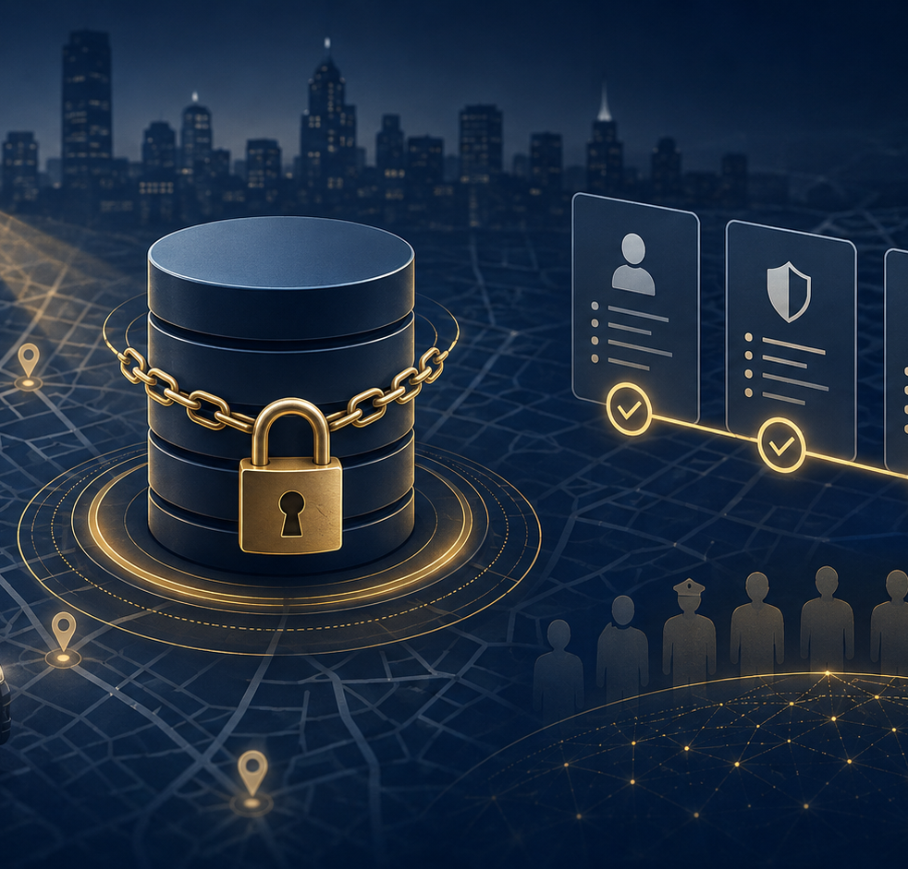
Accountability
Page PD has built safeguards into access, searching, review, and retention — not relying on policy alone.
Restricted access
Search justification
Is limited to trained, authorized personnel with the required security clearance can use the system.
Searches require a legitimate law-enforcement purpose and are tied to documented incident/case information.
Audit trail
Training + consequences
User activity, searches, access, configuration changes, and sharing activity is reviewed.
Users are trained on appropriate use; misuse can lead to investigation, loss of access, and discipline to include possible termination and criminal charges.
Short retention
Human verification
Page PD LPR detections are kept only 7 days, then automatically removed unless preserved as evidence.
An LPR detection is an investigative lead — personnel must review and verify before enforcement action.
Accountability means being able to demonstrate responsible use — through limits, logs, audits, training, and review.
Notes:
[Sources]
Cummulative ALPR Benefit Doc.docx, lines 41-49 and 59-63: restricted access, 7-day retention, audit records and accountability.
08-26 Establishing a Unified Front on LPR Technology Accountability-Summary.docx, lines 42-50: auditing, mandatory search justification, training, system guardrails and IA workflow.
Flock Technology Council & Community Readiness Guide, page 5 / lines 116-124: training, regular audits, written policy and comprehensive logs.
Page PD LPR Council Presentation.pptx, lines 143-178: authorized user, purpose entered, action logged, audit/response workflow.

Slide 4
Misconceptions
Several common concerns describe capabilities that Page PD’s LPR use does not perform.
“It identifies the driver.”
No. The system captures vehicle and plate information. It does not identify who is driving the vehicle.
“It uses facial recognition.”
No. Page PD’s LPR system is designed to identify vehicles, not faces or people.
“It continuously tracks people.”
No. It is not a live feed following an individual. Authorized users may search prior vehicle detections for a legitimate law-enforcement reason.
“A hit means the person is guilty.”
No. A detection or alert is only an investigative lead. Personnel must verify the information and apply law and policy.
“Everyone at the department can search it.”
No. Access is restricted to authorized, trained personnel; it is not automatically available to every employee or officer. (Dispatch/RTCC/Lieutenants)
“Page keeps every plate indefinitely.”
No. Page PD detections are retained for 7 days, unless specific information is preserved as evidence in a case.
A camera can capture a plate. It cannot determine guilt, understand circumstances, or replace due process.
Notes:
[Sources]
Cummulative ALPR Benefit Doc.docx, lines 31, 38-44 and 51-58: no facial recognition, no driver identification, no continuous tracking, restricted access, investigative lead only, 7-day retention.
Flock Technology Council & Community Readiness Guide, page 3 / lines 40-66: what Flock and Flock LPRs do and do not do.
PPD Flock Camera Fact Sheet_08.11.26.docx, lines 69-76: no facial recognition, person tracking, demographic detection, PII or DMV connectivity (comparison source from Peoria PD).

Slide 5
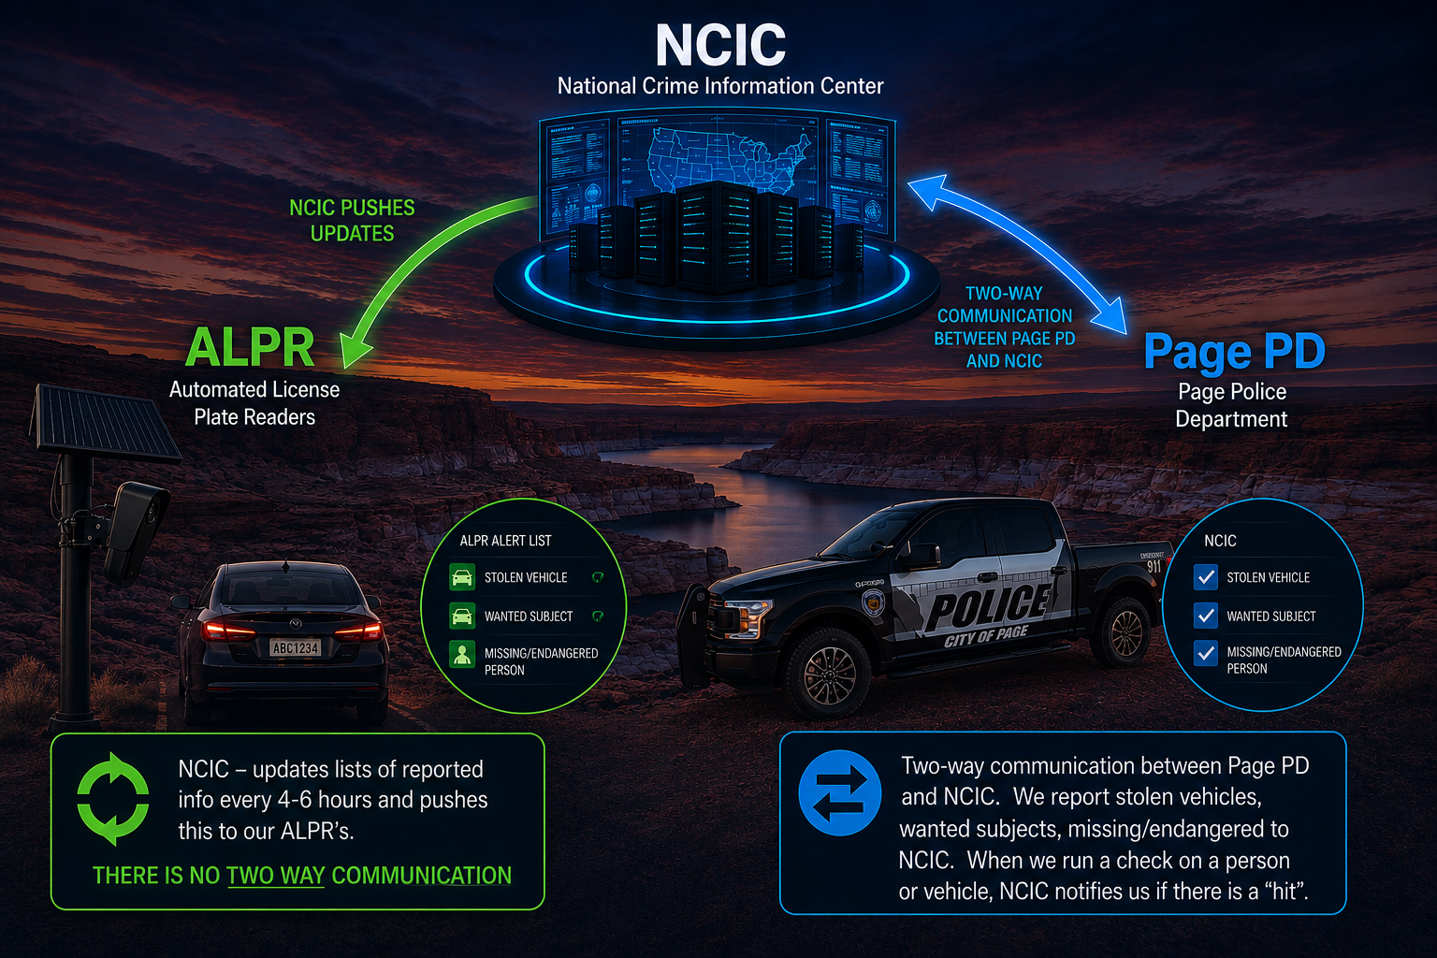
Notes:
[Sources]
Page PD LPR Council Presentation.pptx, title framing and visual identity.
Cummulative ALPR Benefit Doc.docx, lines 64-72: public safety, privacy, constitutional oath, transparency and accountability.

Slide 6
Transparency
Showing the public the rules, limits, and results.
Explain the limits
Regular review
Page PD captures license plate images, vehicle context, visible vehicle details, and detection time/location on public roadways. It does not identify drivers, use facial recognition, monitor speed, issue citations, or continuously track people. Data is retained 7 days.
Page PD uses audit records to review searches, access, sharing relationships, and policy compliance on a routine basis.
Publish the rules
Proactive engagement
Rules limit use to legitimate law-enforcement and public-safety purposes. Access is restricted to trained Lieutenants, Dispatch and RTCC personnel with required clearance. Each search needs a case number, and a documented reason; a plate hit is only a lead and must be verified before action.
Page PD has taken these steps on its own: social media updates when ALPR helps a case, this Council presentation, and a public transparency portal. We will continue proactive communication with Page residents and City officials.
Report outcomes
Responsible disclosure
Page PD provides an ALPR transparency portal for community reference. We will continue public updates on major cases where ALPR assisted, while protecting active investigations, personal information, and raw plate reads.
Page PD will continue to be transparent about program rules and aggregate outcomes while protecting personal information, and sensitive investigations.
Page PD’s message: public safety and constitutional protections are not competing responsibilities — both are part of our duty to the community.
Notes:
[Sources]
Cummulative ALPR Benefit Doc.docx, lines 59-72: accountability, constitutional oath, transparency and public trust framing.
08-25 Law Enforcement Technology, Policy, and Public Trust-Summary.docx, lines 33-40: proactive community engagement, policy transparency and success stories.
08-26 Establishing a Unified Front on LPR Technology Accountability-Summary.docx, lines 64-69: accountability-first communications and transparency artifacts.
Flock Technology Council & Community Readiness Guide, page 6 / lines 137-169: council briefings, stakeholder engagement, outcomes metrics and regular reporting.
Page PD LPR Council Presentation.pptx, lines 323-352: aggregate public reporting, no raw data publication, regular audits and recommended Council message.

Slide 7
Page PD vs. Available Capability & Other Practices
The technology can be configured more broadly. Page PD has chosen a deliberately narrower operating model.
Area
PAGE PD
SYSTEM CAN SUPPORT
DOCUMENTED PRACTICES WITH OTHER DEPARTMENTS
Routine retention
7 days
Agency-configurable
30 days+ is used by most agencies.
User access
Authorized, trained personnel only. (Dispatchers/RTCC/Lieutenants)
Role-based access for multiple groups
Some agencies include RTCC, analysts, officers, detectives and supervisors.
Data sharing
Deliberately controlled by Page PD
AZ Law Enforcement, and 2 neighboring UT counties
No sharing with Federal agencies
Cross-jurisdiction sharing can be enabled
Models vary from local or in-state to broader regional sharing.
Search / alerts
3 of 13 NCIC categories
Missing/Endangered Person
Wanted Person
Stolen Vehicle
Local Hotlist
Hotlists, attributes, alerts and historical searches
Agencies vary in alert categories and search-justification rules.
Camera strategy
Ingress/Egress city-limit focus in Page plan
N/A
Other programs may deploy denser citywide or regional networks. Commonly used every couple blocks along major roads.
Notes:
[Sources]
Cummulative ALPR Benefit Doc.docx, lines 41-49 and 59-66: Page PD restricted access, 7-day retention, audit capability and public-safety purpose.
Page PD LPR Council Presentation.pptx, lines 111-138 and 217-254: Page safeguards and exterior boundary camera strategy.
Flock Technology Council & Community Readiness Guide, pages 3-5 / lines 40-66 and 75-124: configurable retention, role-based access, sharing controls, search justification and audit logs.
PPD Flock Camera Fact Sheet_08.11.26.docx, lines 43-50 and 84-102: Peoria 30-day retention, Arizona-only sharing, monthly audits and 57 authorized users.
08-26 Establishing a Unified Front on LPR Technology Accountability-Summary.docx, lines 42-61: weekly/quarterly audit examples, partner vetting, sharing models and vendor controls.

Slide 8
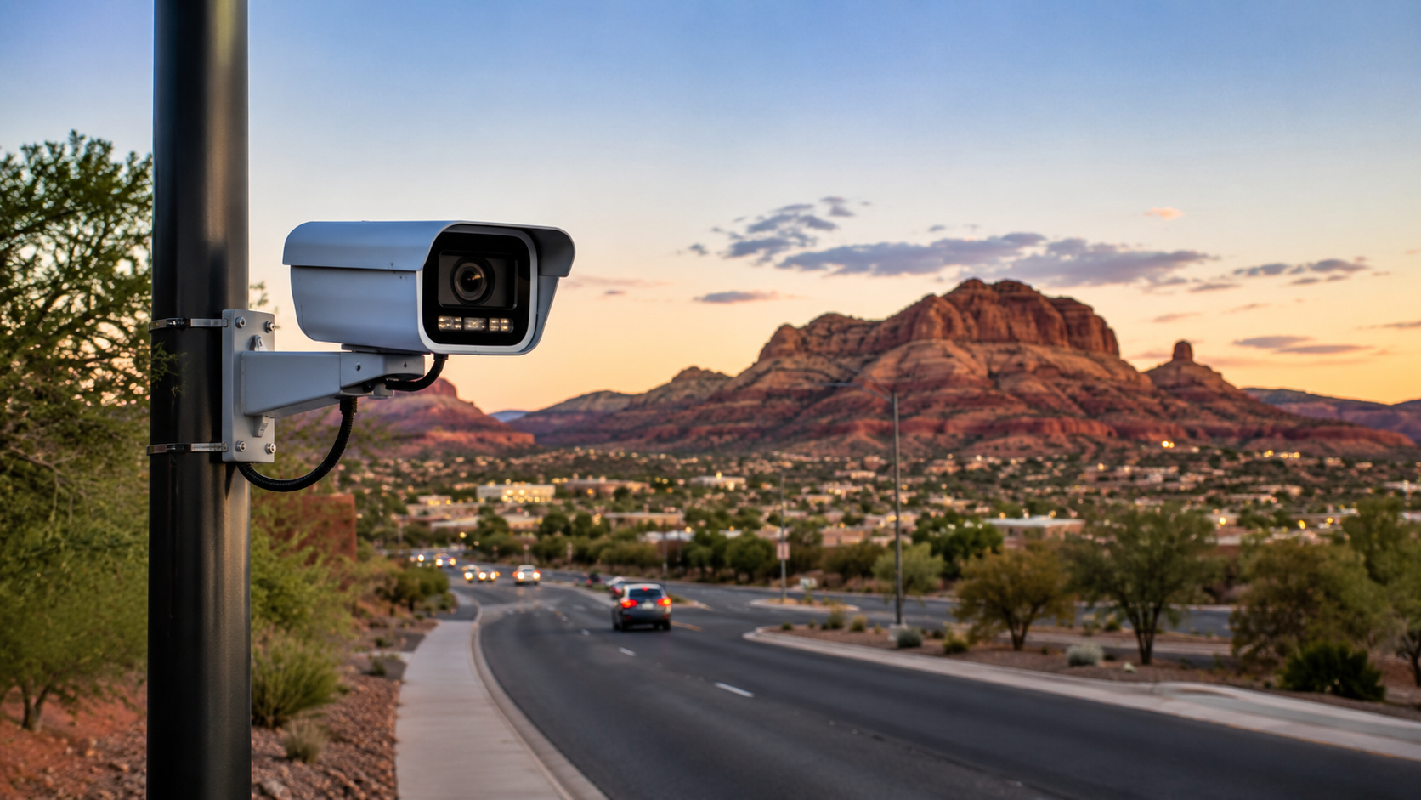
Council Submitted Questions
Page Police Department
Notes:
[Sources]
Reserved slide for Council questions; intentionally left open for later insertion.

Slide 9
What date did we enter into a contract with Flock Safety?
  The first contract was June 2025, two additional contracts were later entered into when adding additional cameras.
What date does our contract with Flock Safety end?
  Because we began the contracts at three different times, they renew on three different dates. Two of the three are due for payment. The third is due next month.
What is the dollar amount of this contract?
  $3000/per camera per year. Currently 10 cameras for $30,000/year.
What does the contract include?
  The contract between the Page Police Department and Flock Safety includes a 12-month subscription for ten Flock Safety Falcon LPR cameras, along with access to the Flock Safety Platform. The platform includes license plate and vehicle description searching, time-and-location-based searches, NCIC alerts, custom hot lists, and access to state, nationwide, law-enforcement, and community networks where authorized. The agreement also includes professional installation, electrical installation, ongoing monitoring, maintenance, technical support, and repair or replacement of defective equipment. Page PD has established a 7-day data retention period, after which LPR data is deleted unless it has been lawfully preserved as evidence for an investigation. The agreement further establishes rules governing authorized users, permissible law-enforcement use, data ownership and sharing, confidentiality and security, installation and maintenance responsibilities, warranties and liability, insurance requirements, renewal, and termination. Page PD retains ownership of its data, while Flock is granted limited rights necessary to provide the contracted services; the agreement states that Flock does not own or sell Page PD's data.
Notes:
[Sources]
Cummulative ALPR Benefit Doc.docx, lines 59-72: accountability, constitutional oath, transparency and public trust framing.
08-25 Law Enforcement Technology, Policy, and Public Trust-Summary.docx, lines 33-40: proactive community engagement, policy transparency and success stories.
08-26 Establishing a Unified Front on LPR Technology Accountability-Summary.docx, lines 64-69: accountability-first communications and transparency artifacts.
Flock Technology Council & Community Readiness Guide, page 6 / lines 137-169: council briefings, stakeholder engagement, outcomes metrics and regular reporting.
Page PD LPR Council Presentation.pptx, lines 323-352: aggregate public reporting, no raw data publication, regular audits and recommended Council message.

Slide 10
Are there any early cancellation fees or penalties in the contract?
  The contract states: “Customer shall have the right to terminate this Agreement for non-appropriation with thirty (30) days written notice without penalty or other cost.”
How many Flock products does PPD have?
  10 – 8 that are currently in use
What models are they?
  Flock Falcon
Where are they located?
(2) Coppermine (Big Lake)
(2) LPB, by Library
(2) LPB, Near Rim View Drive
(2) State border (out of service)
(1) South Access
(1) HSB
Do they have the hardware ability to record ANY form of audio?
  No
Are we utilizing any audio recording, and in what form?
  No
Notes:
[Sources]
Cummulative ALPR Benefit Doc.docx, lines 59-72: accountability, constitutional oath, transparency and public trust framing.
08-25 Law Enforcement Technology, Policy, and Public Trust-Summary.docx, lines 33-40: proactive community engagement, policy transparency and success stories.
08-26 Establishing a Unified Front on LPR Technology Accountability-Summary.docx, lines 64-69: accountability-first communications and transparency artifacts.
Flock Technology Council & Community Readiness Guide, page 6 / lines 137-169: council briefings, stakeholder engagement, outcomes metrics and regular reporting.
Page PD LPR Council Presentation.pptx, lines 323-352: aggregate public reporting, no raw data publication, regular audits and recommended Council message.

Slide 11
Is PPD utilizing any other products from Flock Safety?
  No
Is PPD utilizing any similar products in a similar capacity from companies other than Flock Safety (Vigilant, Axon, etc.)?
  No other LPR’s at this time.
What positions within PPD have access to search our data?
  (2) Lieutenants, (2) RTCC operators, (7) dispatchers
What positions within PPD have access to other departments' data?
  (2) Lieutenants, (2) RTCC operators, (7) dispatchers
How do we log the searches made by PPD staff?
  Automatically in Flock's audit system. Searches are tied to individual users and logged. It is also noted in the case notes of our RMS if an LPR search was conducted.
What level of proof does a case need before PPD staff can run a search in the Flock system?
  A legitimate investigative reason.
What severity of a crime does a case need before PPD staff can run a search in the Flock system?
  A legitimate investigative reason.
Notes:
[Sources]
Cummulative ALPR Benefit Doc.docx, lines 59-72: accountability, constitutional oath, transparency and public trust framing.
08-25 Law Enforcement Technology, Policy, and Public Trust-Summary.docx, lines 33-40: proactive community engagement, policy transparency and success stories.
08-26 Establishing a Unified Front on LPR Technology Accountability-Summary.docx, lines 64-69: accountability-first communications and transparency artifacts.
Flock Technology Council & Community Readiness Guide, page 6 / lines 137-169: council briefings, stakeholder engagement, outcomes metrics and regular reporting.
Page PD LPR Council Presentation.pptx, lines 323-352: aggregate public reporting, no raw data publication, regular audits and recommended Council message.

Slide 12
Does PPD staff need to obtain a warrant before running a search on our own data within the Flock system?
A warrant is not legally required.
Does PPD staff need to obtain a warrant before running a search on other agencies' data within the Flock system?
  A warrant is not legally required.
Does PPD have a staff member that individually approves the use of the Flock system on a case-by-case basis (and a paper trail to support it)?
  Yes, a supervisor grants access to a user after the user has gone through the appropriate training, read department policy and has passed a test.
What outside LE agencies have access to our data?
  The exact agencies can be viewed on our PD transparency portal. We only share with agencies in Arizona or an out-of-state county that borders Coconino County, which currently does not apply as they do not have Flock (Kane/San Juan County, Ut.)
What level of proof does a case need before outside LE staff can run a search in the Flock system?
  They are regulated by their own department policy and are subject to auditing and disciplinary action for misuse.
What severity of a crime does a case need before outside LE staff can run a search in the Flock system?
  This would be based on their department’s policy.
Notes:
[Sources]
Cummulative ALPR Benefit Doc.docx, lines 59-72: accountability, constitutional oath, transparency and public trust framing.
08-25 Law Enforcement Technology, Policy, and Public Trust-Summary.docx, lines 33-40: proactive community engagement, policy transparency and success stories.
08-26 Establishing a Unified Front on LPR Technology Accountability-Summary.docx, lines 64-69: accountability-first communications and transparency artifacts.
Flock Technology Council & Community Readiness Guide, page 6 / lines 137-169: council briefings, stakeholder engagement, outcomes metrics and regular reporting.
Page PD LPR Council Presentation.pptx, lines 323-352: aggregate public reporting, no raw data publication, regular audits and recommended Council message.

Slide 13
Do staff from other agencies need to obtain a warrant before running a search on our data within the Flock system?
A warrant is not legally required.
How do we log the searches made by outside LE agencies?
Automatically in Flock's audit system. Searches are tied to individual users and logged.
What outside non-LE agencies have access to our data?
NONE
Do Flock employees have access to our data?
  Flock employees do not have unrestricted or routine access to customer data. Access is limited to authorized personnel with a legitimate business need, such as customer support, troubleshooting, security, or contractual obligations. Access is governed by role-based permissions, least-privilege controls, multifactor authentication, and employee screening. CJIS-related environments have additional access requirements. Access activities are logged for auditability.
Where is the data physically stored?
  Customer data is hosted in U.S.-based cloud infrastructure operated by Amazon Web Services (AWS). CJIS-related data is hosted in AWS GovCloud. Data is encrypted in transit and at rest. AWS uses geographically distributed facilities; exact data-center addresses are not publicly disclosed for security reasons. The applicable AWS region and service environment can depend on the product and compliance requirements.
Notes:
[Sources]
Cummulative ALPR Benefit Doc.docx, lines 59-72: accountability, constitutional oath, transparency and public trust framing.
08-25 Law Enforcement Technology, Policy, and Public Trust-Summary.docx, lines 33-40: proactive community engagement, policy transparency and success stories.
08-26 Establishing a Unified Front on LPR Technology Accountability-Summary.docx, lines 64-69: accountability-first communications and transparency artifacts.
Flock Technology Council & Community Readiness Guide, page 6 / lines 137-169: council briefings, stakeholder engagement, outcomes metrics and regular reporting.
Page PD LPR Council Presentation.pptx, lines 323-352: aggregate public reporting, no raw data publication, regular audits and recommended Council message.

Slide 14
Who owns the equipment on which the data is physically stored?
  The customer owns its data. Under the Flock subscription model, Flock owns or retains the camera equipment, while AWS owns and operates the underlying cloud infrastructure and physical storage media. Customers generally do not own the AWS servers or storage devices.
How long do we have access to our own data for?
  Flock only retains Page PD data for 7 days. However, there is no single retention period for every customer. Retention is determined by the applicable agreement, product, and customer configuration. Existing LPR deployments commonly use a defined period such as 30 days, while newer configurations may use a shorter period.
  After the applicable retention period, eligible data is permanently deleted and is not retained in a backup or cold-storage archive for later recovery, subject to any applicable legal hold or evidence-preservation process.
  Independent assurance is available at the infrastructure and control level through AWS security attestations and certifications, together with Flock’s security and compliance materials. These reports validate the operation of defined controls; they are not a separate independent certificate for every individual customer-data deletion.
How long do other organizations have access to our data for?
7 days and only if they are an agency we are sharing with.
Notes:
[Sources]
Cummulative ALPR Benefit Doc.docx, lines 59-72: accountability, constitutional oath, transparency and public trust framing.
08-25 Law Enforcement Technology, Policy, and Public Trust-Summary.docx, lines 33-40: proactive community engagement, policy transparency and success stories.
08-26 Establishing a Unified Front on LPR Technology Accountability-Summary.docx, lines 64-69: accountability-first communications and transparency artifacts.
Flock Technology Council & Community Readiness Guide, page 6 / lines 137-169: council briefings, stakeholder engagement, outcomes metrics and regular reporting.
Page PD LPR Council Presentation.pptx, lines 323-352: aggregate public reporting, no raw data publication, regular audits and recommended Council message.

Slide 15
How long does Flock Safety keep our data saved? Are there independent audits available to prove this?
  Flock keeps Page PD data for 7 Days. However, there is no single retention period for every customer. Retention is determined by the applicable agreement, product, and customer configuration. Existing LPR deployments commonly use a defined period such as 30 days, while newer configurations may use a shorter period. After the applicable retention period, eligible data is permanently deleted and is not retained in a backup or cold-storage archive for later recovery, subject to any applicable legal hold or evidence-preservation process.
  Independent assurance is available at the infrastructure and control level through AWS security attestations and certifications, together with Flock’s security and compliance materials. These reports validate the operation of defined controls; they are not a separate independent certificate for every individual customer-data deletion.
. How does Flock Safety decommission hardware? Are there independent audits available to prove this?
  Flock-managed field equipment is removed through a controlled process. Equipment and storage media are sanitized using secure-erasure procedures when possible; media that cannot be reliably sanitized is physically destroyed. AWS applies its media-sanitization and destruction controls to cloud storage hardware, including cryptographic erasure and physical destruction processes consistent with recognized media-sanitization standards.
  AWS’s independent assurance reports cover the applicable cloud-infrastructure controls. A customer-specific chain-of-custody or destruction certificate is not automatically issued for every camera or cloud-storage device, but can be addressed through the applicable support or security-review process.
Notes:
[Sources]
Cummulative ALPR Benefit Doc.docx, lines 59-72: accountability, constitutional oath, transparency and public trust framing.
08-25 Law Enforcement Technology, Policy, and Public Trust-Summary.docx, lines 33-40: proactive community engagement, policy transparency and success stories.
08-26 Establishing a Unified Front on LPR Technology Accountability-Summary.docx, lines 64-69: accountability-first communications and transparency artifacts.
Flock Technology Council & Community Readiness Guide, page 6 / lines 137-169: council briefings, stakeholder engagement, outcomes metrics and regular reporting.
Page PD LPR Council Presentation.pptx, lines 323-352: aggregate public reporting, no raw data publication, regular audits and recommended Council message.

Slide 16
How does Flock Safety decommission hardware? Are there independent audits available to prove this?
  Flock-managed field equipment is removed through a controlled process. Equipment and storage media are sanitized using secure-erasure procedures when possible; media that cannot be reliably sanitized is physically destroyed. AWS applies its media-sanitization and destruction controls to cloud storage hardware, including cryptographic erasure and physical destruction processes consistent with recognized media-sanitization standards. AWS’s independent assurance reports cover the applicable cloud-infrastructure controls. A customer-specific chain-of-custody or destruction certificate is not automatically issued for every camera or cloud-storage device, but can be addressed through the applicable support or security-review process.
How/when does Flock Safety delete data? Are there independent audits available to prove this?
  Deletion is handled through automated retention and lifecycle controls. Eligible data is removed when the configured retention period expires. Deletion is intended to be irreversible. Account closure, a legal hold, or a separately requested evidence-preservation process may affect the applicable schedule.
  Flock and AWS maintain system logs and control evidence for the deletion process. AWS independent assurance reports and Flock’s security and compliance materials provide evidence that the relevant control environment is designed and operated appropriately. They do not constitute a separate independent audit of each individual deletion event.
Does Flock Safety give or sell data to any third parties? Are there independent audits available to prove this?
The contract specifically prohibits Flock from selling data. This would be a major breach of contract.
Notes:
[Sources]
Cummulative ALPR Benefit Doc.docx, lines 59-72: accountability, constitutional oath, transparency and public trust framing.
08-25 Law Enforcement Technology, Policy, and Public Trust-Summary.docx, lines 33-40: proactive community engagement, policy transparency and success stories.
08-26 Establishing a Unified Front on LPR Technology Accountability-Summary.docx, lines 64-69: accountability-first communications and transparency artifacts.
Flock Technology Council & Community Readiness Guide, page 6 / lines 137-169: council briefings, stakeholder engagement, outcomes metrics and regular reporting.
Page PD LPR Council Presentation.pptx, lines 323-352: aggregate public reporting, no raw data publication, regular audits and recommended Council message.

Slide 17
Is PPD notified when an outside agency accesses data generated from our cameras?
  Customers are not normally sent a real-time notification for each authorized Flock support or operational access. Access activity is recorded in Flock’s audit logs, which authorized customer administrators can review. For a specific support engagement, the customer may request an access summary through its Flock support contact.
Is PPD notified when a Flock Safety employee accesses data generated from our cameras?
  Not established as an automatic per-access notification. Flock says privileged employee access is controlled and audited; its InfoSec terms require customer notification for confirmed security incidents affecting customer data, but that is different from notifying PPD for every legitimate support/maintenance access. If a Flock agent makes any changes in our system it is logged in our internal event logs.
Notes:
[Sources]
Cummulative ALPR Benefit Doc.docx, lines 59-72: accountability, constitutional oath, transparency and public trust framing.
08-25 Law Enforcement Technology, Policy, and Public Trust-Summary.docx, lines 33-40: proactive community engagement, policy transparency and success stories.
08-26 Establishing a Unified Front on LPR Technology Accountability-Summary.docx, lines 64-69: accountability-first communications and transparency artifacts.
Flock Technology Council & Community Readiness Guide, page 6 / lines 137-169: council briefings, stakeholder engagement, outcomes metrics and regular reporting.
Page PD LPR Council Presentation.pptx, lines 323-352: aggregate public reporting, no raw data publication, regular audits and recommended Council message.

Slide 18
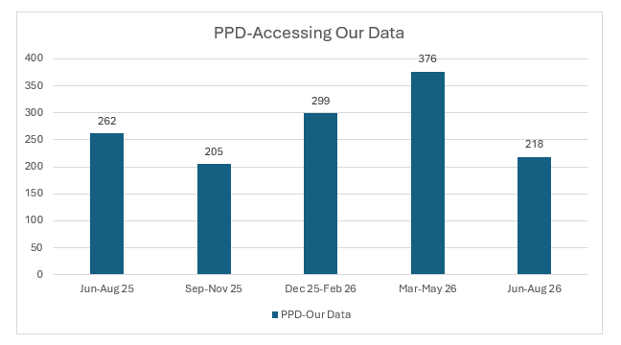
For how many cases has PPD accessed our own data since the start of the contract?
Notes:
[Sources]
Cummulative ALPR Benefit Doc.docx, lines 59-72: accountability, constitutional oath, transparency and public trust framing.
08-25 Law Enforcement Technology, Policy, and Public Trust-Summary.docx, lines 33-40: proactive community engagement, policy transparency and success stories.
08-26 Establishing a Unified Front on LPR Technology Accountability-Summary.docx, lines 64-69: accountability-first communications and transparency artifacts.
Flock Technology Council & Community Readiness Guide, page 6 / lines 137-169: council briefings, stakeholder engagement, outcomes metrics and regular reporting.
Page PD LPR Council Presentation.pptx, lines 323-352: aggregate public reporting, no raw data publication, regular audits and recommended Council message.

Slide 19
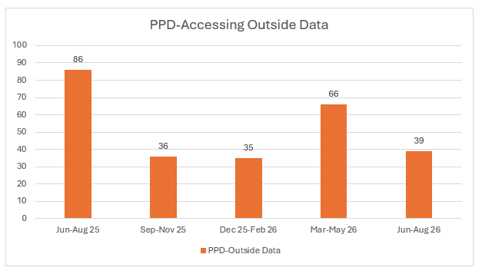
For how many cases has PPD accessed other agencies' data since the start of the contract?
Notes:
[Sources]
Cummulative ALPR Benefit Doc.docx, lines 59-72: accountability, constitutional oath, transparency and public trust framing.
08-25 Law Enforcement Technology, Policy, and Public Trust-Summary.docx, lines 33-40: proactive community engagement, policy transparency and success stories.
08-26 Establishing a Unified Front on LPR Technology Accountability-Summary.docx, lines 64-69: accountability-first communications and transparency artifacts.
Flock Technology Council & Community Readiness Guide, page 6 / lines 137-169: council briefings, stakeholder engagement, outcomes metrics and regular reporting.
Page PD LPR Council Presentation.pptx, lines 323-352: aggregate public reporting, no raw data publication, regular audits and recommended Council message.

Slide 20
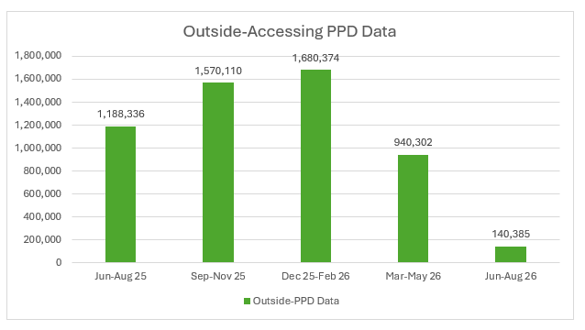
How many times have other agencies accessed our data since the start of the contract?
Notes:
[Sources]
Cummulative ALPR Benefit Doc.docx, lines 59-72: accountability, constitutional oath, transparency and public trust framing.
08-25 Law Enforcement Technology, Policy, and Public Trust-Summary.docx, lines 33-40: proactive community engagement, policy transparency and success stories.
08-26 Establishing a Unified Front on LPR Technology Accountability-Summary.docx, lines 64-69: accountability-first communications and transparency artifacts.
Flock Technology Council & Community Readiness Guide, page 6 / lines 137-169: council briefings, stakeholder engagement, outcomes metrics and regular reporting.
Page PD LPR Council Presentation.pptx, lines 323-352: aggregate public reporting, no raw data publication, regular audits and recommended Council message.

Slide 21
Who is responsible for updating the software of the Flock devices?
  Flock. This is part of what the yearly fee’s cover.
Is there a patch log or other audit available to show updates applied to devices, and the vulnerabilities that have been addressed?
  Flock maintains device and software release records, update-status information, vulnerability-management records, and security-testing evidence. Camera software updates are delivered through controlled over-the-air deployment processes, and vulnerabilities are tracked and remediated according to severity.
  A public, per-camera patch history is not automatically published because it could expose device and security details. A customer can request an asset-specific update-status report or a security summary through Flock’s support or security-review process.
A plain-language explanation to the public of exactly what data is captured, how long it is retained, and who inside and outside Page PD can query it.
  Addressed in previous questions posed by Counsellor Preller.
  ~ (a license plate number, physical identifiers of the vehicle ie: color, make, model, vehicle damage, ` decals/stickers etc.)
  ~ (7 days)
  ~ (2 Lt.’s, RTCC, Dispatch)
Written confirmation of whether data sharing with federal, out-of-state, or other outside agencies is enabled by default, and how the department would disable or restrict it.
  We do not share data with any Federal or any other agency by default. We only share data with state agencies in Arizona.
Notes:
[Sources]
Cummulative ALPR Benefit Doc.docx, lines 59-72: accountability, constitutional oath, transparency and public trust framing.
08-25 Law Enforcement Technology, Policy, and Public Trust-Summary.docx, lines 33-40: proactive community engagement, policy transparency and success stories.
08-26 Establishing a Unified Front on LPR Technology Accountability-Summary.docx, lines 64-69: accountability-first communications and transparency artifacts.
Flock Technology Council & Community Readiness Guide, page 6 / lines 137-169: council briefings, stakeholder engagement, outcomes metrics and regular reporting.
Page PD LPR Council Presentation.pptx, lines 323-352: aggregate public reporting, no raw data publication, regular audits and recommended Council message.

Slide 22
A public audit/reporting mechanism showing how many searches were run, for what stated purpose, and whether any misuse was found.
  We conduct weekly audits. We audit every single search that our staff makes in the system. This is more thorough than ACJIS criminal history auditing conducted by the state which requires an even higher level of security clearance.
Written policy on what happens if Flock (or any vendor) is acquired by another company or changes its terms of service.
  This is covered in our contract, and we would have the right to discontinue services with Flock in the event that this happens.
A clear presentation of the realistic options before the council and public: continue as-is, modify (shorter retention, restricted
  Provided.
Notes:
[Sources]
Cummulative ALPR Benefit Doc.docx, lines 59-72: accountability, constitutional oath, transparency and public trust framing.
08-25 Law Enforcement Technology, Policy, and Public Trust-Summary.docx, lines 33-40: proactive community engagement, policy transparency and success stories.
08-26 Establishing a Unified Front on LPR Technology Accountability-Summary.docx, lines 64-69: accountability-first communications and transparency artifacts.
Flock Technology Council & Community Readiness Guide, page 6 / lines 137-169: council briefings, stakeholder engagement, outcomes metrics and regular reporting.
Page PD LPR Council Presentation.pptx, lines 323-352: aggregate public reporting, no raw data publication, regular audits and recommended Council message.

Slide 23
Thank You
Notes:
[Sources]
Page PD LPR Council Presentation.pptx, title framing and visual identity.
Cummulative ALPR Benefit Doc.docx, lines 64-72: public safety, privacy, constitutional oath, transparency and accountability.

